Slide 1
Generators and Iterables
Introduction to generators
Generator techniques
Annexes
Standard iterables
Custom iterables

Slide 2
Section 1: Introduction to Generators
Defining a generator function
Using a generator function
Example

Slide 3
Defining a Generator Function
A generator is a function decorated with *
Yields successive values back to the client one at a time, via the yield keyword
function * myGeneratorFunction() {
// Some work, then yield a value to client.
yield someValue
// Some more work, then yield next value.
yield anotherValue
// Etc.
}
3

Slide 4
Using a Generator Function (1 of 2)
Client code calls the generator function as follows:
The function returns a generator object immediately
It hasn't actually executed any code in the function yet
let genObj = myGeneratorFunction()
4

Slide 5
Using a Generator Function (2 of 2)
Client calls next() on the generator object:
This causes the generator to start executing
Function executes all statements up to first yield
The function yields control (and a value?) back to client
Client receives object with {done,value} properties
let res1 = genObj.next()
console.log(res1.done, res1.value)
5

Slide 6
Example Generator Function
Consider this generator function:
function * ducklingGenerator() {
console.log("\nGenerating duckling #1")
yield "Huey"
console.log("\nGenerating duckling #2")
yield "Luey"
console.log("\nGenerating duckling #3")
yield "Duey"
}
6

Slide 7
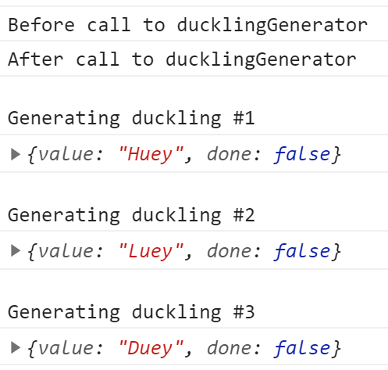
Example Client Code
Now consider this client code:
console.log("Before call to ducklingGenerator")
let genObj = ducklingGenerator()
console.log("After call to ducklingGenerator")
let res1 = genObj.next()
console.log(res1)
let res2 = genObj.next()
console.log(res2)
let res3 = genObj.next()
console.log(res3)
7

Slide 8
Section 2: Generator Techniques
Using a generator with for-of
Using yield vs. return
Example
Additional ways to define a generator

Slide 9
Using a Generator with for-of
You can use a generator with a for-of loop
The call to the function returns a generator object
Each iteration calls next() on the generator object
The function executes up to next yield statement, and returns a {done,value} object
The loop assigns value property to the loop variable
The loop stops when the function falls off the end
for (let res of ducklingGenerator())
console.log(res)
9

Slide 10
Using yield vs. return
When a generator function hits a yield statement
It yields to the client and returns {done,value} object
The done property is false ("we ain't done yet")
A generator can also have a return statement
Terminates function and returns {done,value} object
The done property is true ("that's all folks")
See example on next slide
10

Slide 11
Example Generator Function
Note the return statement in this generator function:
function * ducklingGenerator() {
console.log("\nGenerating duckling #1")
yield "Huey"
console.log("\nGenerating duckling #2")
yield "Luey"
console.log("\nGenerating duckling #3")
return "Duey"
}
11

Slide 12
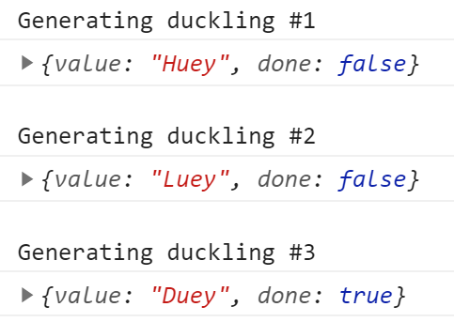
Example Client Code
Consider this client code:
let genObj = ducklingGenerator()
let res1 = genObj.next()
console.log(res1)
let res2 = genObj.next()
console.log(res2)
let res3 = genObj.next()
console.log(res3)
12

Slide 13
Additional Ways to Define a Generator
You can also define a generator function as:
A function expression, or a method in an object/class
const genFunc = function * () { … … … }
const obj = {
* someGeneratorMethod() { … … … }
}
class SomeClass {
* someGeneratorMethod() { … … … }
}
13

Slide 14
Summary
Introduction to generators
Generator techniques

Slide 15
Annex: Standard Iterables
Iterable data structures
Iteration examples
How iteration works

Slide 16
Iterable Data Structures (1 of 2)
ES6++ supports the concept of iterable data structures
Data structures whose elements can be iterated over
By definition, an iterable data structure has:
A method named Symbol.iterator
This method returns an iterator object (see later)
16

Slide 17
Iterable Data Structures (2 of 2)
The following data structures are iterable in ES6++:
Arrays and typed arrays
Strings
Maps
Sets
DOM data structures. e.g. NodeList
Promises (see later)
Your own custom types (exciting ☺, see later)
17

Slide 18
Iteration Examples (1 of 4)
You can use iteration in lots of places in ES6++
We'll see some examples on the next few slides
Then we'll explain what's happening under the covers
Here's how to use iteration in a for-of loop
let numbers = [3, 12, 19, 1, 2, 7]
for (let n of numbers)
console.log(n)
18

Slide 19
Iteration Examples (2 of 4)
Another iteration scenario is when you create a Map or Set from an array
The Map/Set constructor has to iterate over the array, to populate the Map/Set
let emps = new Map([['1','Jo'], ['2','Mo']])
let lotto = new Set([3, 12, 19, 1, 2, 7])
19

Slide 20
Iteration Examples (3 of 4)
Another iteration scenario is Array.from()
Iterates over incoming items, to populate the array
let lotto = new Set([3, 12, 19, 1, 2, 7])
let array = Array.from(lotto)
20

Slide 21
Iteration Examples (4 of 4)
Another iteration scenario is the spread operator ...
Iterates over items, to separate them
let lotto = new Set([3, 12, 19, 1, 2, 7])
let [item0, item1] = [...lotto]
21

Slide 22
How Iteration Works (1 of 4)
Consider the following use of iteration in for-of loop
This is what happens under the covers:
Calls Symbol.iterator(), returns an iterator
The iterator has a next() method, to go to next item
next() returns an object with {done,value} props
See next slide…
let numbers = [3, 12, 19, 1, 2, 7]
for (let n of numbers)
console.log(n)
22

Slide 23
How Iteration Works (2 of 4)
This is how for-of iteration works under the covers:
let numbers = [3, 12, 19, 1, 2, 7]
for (let n of numbers)
console.log(n)
let iter = numbers[Symbol.iterator]()
while (true) {
let i = iter.next()
if (i.done)
break
console.log(i.value)
}
23

Slide 24
How Iteration Works (3 of 4)
This is how Map iteration works under the covers:
let emps = new Map([['1','Jo'], ['2','Mo']])
for (let p of emps)
console.log(`${p[0]} ${p[1]}`)
let iter = emps[Symbol.iterator]()
while (true) {
let i = iter.next()
if (i.done)
break
console.log(`${i.value[0]} ${i.value[1]}`)
}
24

Slide 25
How Iteration Works (4 of 4)
This is how Set iteration works under the covers:
let lotto = new Set([3, 12, 19, 1, 2, 7])
for (let number of lotto)
console.log(number)
let iter = lotto[Symbol.iterator]()
while (true) {
let i = iter.next()
if (i.done)
break
console.log(i.value)
}
25

Slide 26
Annex: Custom Iterables
Overview
Understanding iterables
Implementing an iterable object
Using an iterable object
Iterable/iterator as one object
Phased iteration

Slide 27
Overview
In the previous section, we discussed some standard ES6++ iterable data structures
Array, String, Map, Set, etc.
You can also define your own custom iterable objects
We'll see how to do this in this section
27

Slide 28
Understanding Iterables
An iterable object has:
A Symbol.iterator method, returns an iterator
An iterator object has:
A next method, returns an iterator result object
An iterator result object:
Has done and/or value properties
If done is true, it causes iteration to stop
If done is false, value is result of current iteration
28

Slide 29
Implementing an Iterable Object
let squareIterable = {
[Symbol.iterator]() {
let n = 0
let iterator = {
next() {
if (++n <= 5)
return {done:false, value:n*n}
else
return {done:true, value:undefined}
}
}
return iterator
}
}
29

Slide 30
Using an Iterable Object
You can use an iterable object in all iteration scenarios
for (let n of squareIterable)
console.log(n)
let lotto = new Set(squareIterable)
console.log(lotto)
let array = Array.from(squareIterable)
console.log(array)
let [item0, item1] = [...squareIterable]
console.log(item0, item1)
30

Slide 31
Iterable/Iterator as One Object (1 of 3)
Take another look at the Symbol.iterator method
It returns an iterator object as a separate object here
The iterator can be any object with a next method
let squareIterable = {
[Symbol.iterator]() {
let iterator = {
next() { … }
}
return iterator
}
}
31

Slide 32
Iterable/Iterator as One Object (2 of 3)
It's conventional to define the next method on the iterable object itself
Rather than on a separate object
This means the iterable object is also an iterator object
So the Symbol.iterator method just returns this
See next slide for an example of how to do this
Then we'll discuss "why" ☺
32

Slide 33
Iterable/Iterator as One Object (3 of 3)
let squareIterable = {
n: 0,
[Symbol.iterator]() { return this },
next() {
if (++this.n <= 5)
return {done:false, value:this.n*this.n}
else
return {done:true, value:undefined}
}
}
33

Slide 34
Phased Iteration (1 of 2)
If you implement iterable/iterator as a single object:
You can use it to perform phased iteration
Iterate part of collection, then iterate the rest later
See the example on the next slide
34

Slide 35
Phased Iteration (2 of 2)
let array = ['A1','A2',' ','B1','B2','B3']
// Call Symbol.iterator(), returns an iterator.
let iter = array[Symbol.iterator]()
// The iterator is also an iterable, so use it
// in a for-of loop to get items up to ' '.
for (let i of iter)
if (i.trim().length == 0)
break
// Iterate over the rest of the items.
for (let i of iter)
console.log(i)
35

